Slide 1
Component modeling
Cong-Toan TRAN

Slide 2
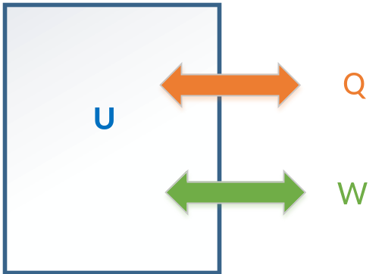
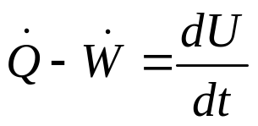


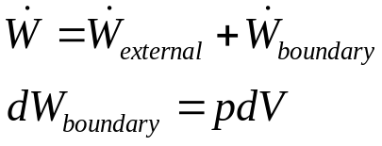

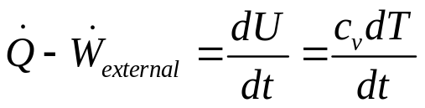

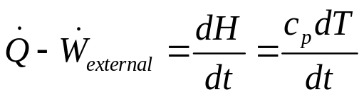
1er principe de la thermodynamique
Système fermé: pas de flux de matière au travers de la frontière
Bilan d’énergie (énergies macroscopiques négligées)
  Par convention:
    Chaleur absorbée par le system: positif
    Travail produit par le system: positif
  2 types de travail:
    Travail externe donné par un moyen extérieur
    Travail de frontière lié à la dilatation du système
Pour une évolution à volume constant (isochore):
Pour une évolution à pression constant (isobar):
(c_{v}: chaleur spécifique à volume constant )
(c_{p}: chaleur spécifique à pression constant )

Slide 3
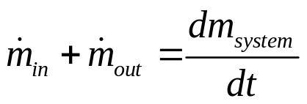
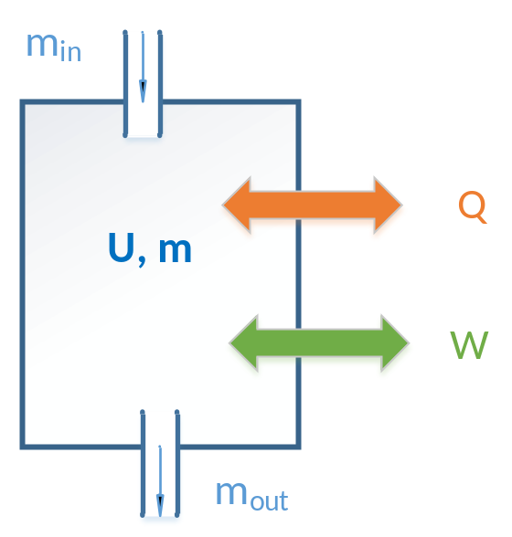


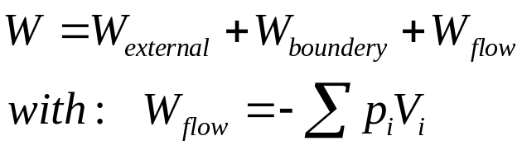
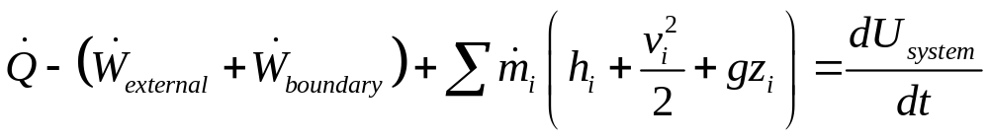
1er principe de la thermodynamique
Système ouvert: échange de matière possible au travers de la frontière
Conservation de masse (ou bilan de masse)
  Par convention: positif, négatif
Travail d’écoulement d’un fluide entrant ou sortant d’un système:
Conservation d’énergie (ou bilan d’énergie)
(les énergies potentielles et cinétiques souvent négligées)

Slide 4
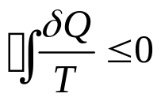
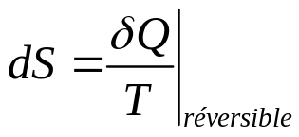
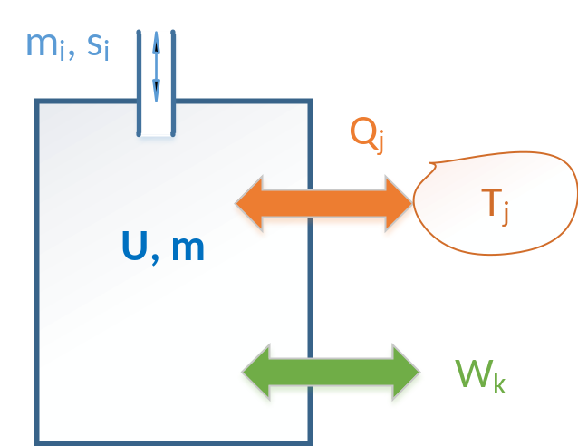
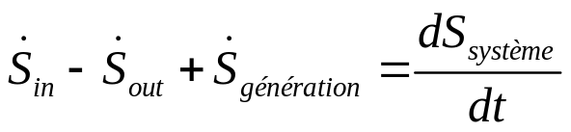
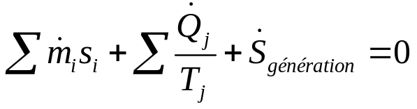
2ème principe de la thermodynamique
« La chaleur ne passe pas spontanément d’un corps froid sur un corps chaud »
Inégalité de Clausius:
  L’égalité → procédé réversible
  Sinon, irréversible
Définition de l’entropie:
  s est aussi une variable d’état
Principe de la génération d’entropie:
  En condition stabilisée:

Slide 5
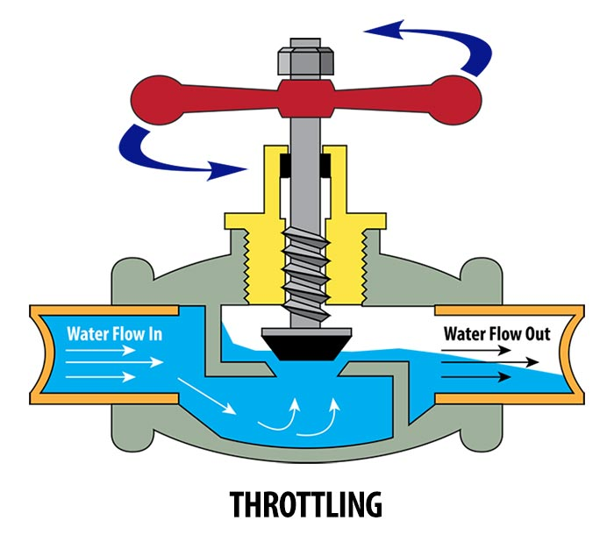

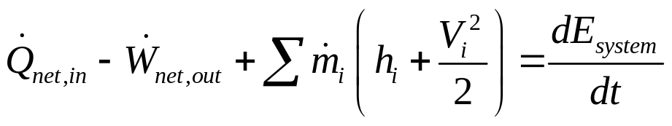

Expansion valve modeling
Modeling assumptions:
  No mechanical work → W=0
  Small external surface → Q=0
  Small control volume → E_{system}, m_{system} neglicted
  Kinetic energy neglected
Model:
  Flow rate controlled by the opening level of the valve
    k: parameter of the valve, generally determined thanks to nominal working points
    opening : between 0 (closed) and 1 (completely opened)
  Quasi-isenthalpic expansion process:

Slide 6
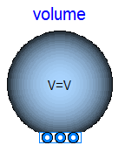
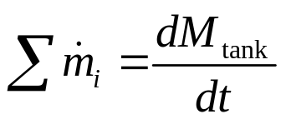
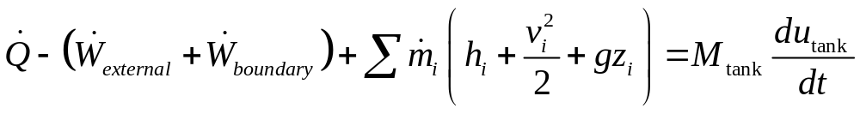
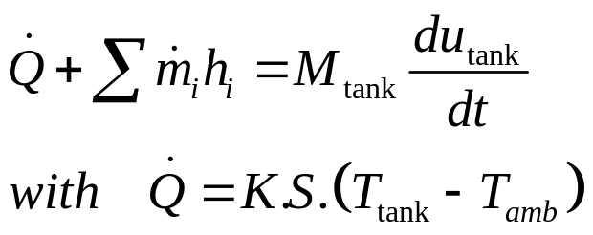
Closed tank
Modeling assumptions:
  No mechanical work → W=0
  Kinetic and potential energies neglected
  Small control volume ?
  Small external surface ?
Mass balance:
Energy balance:

Slide 7
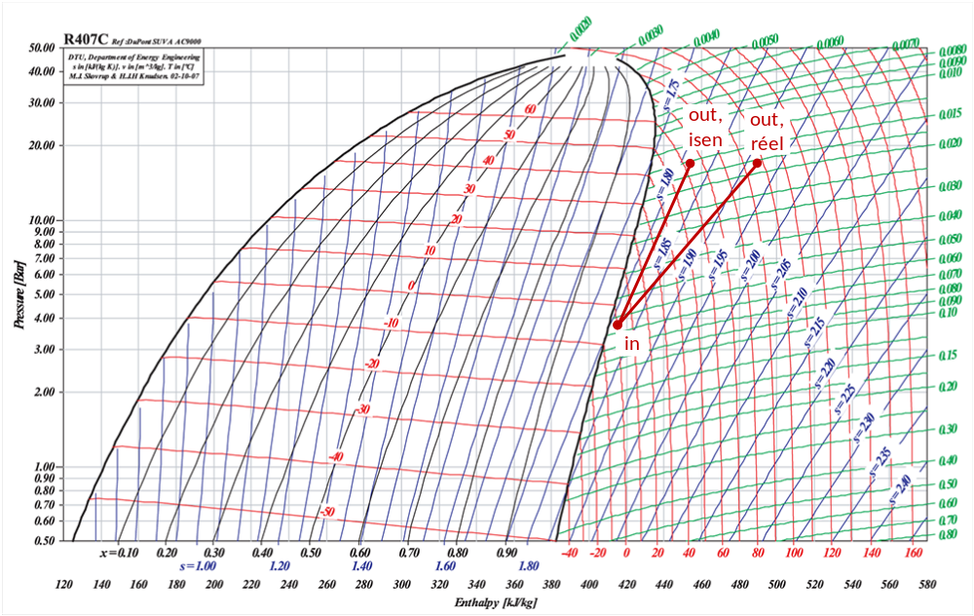
Compression modeling (1)
Ideal and real processes

Slide 8
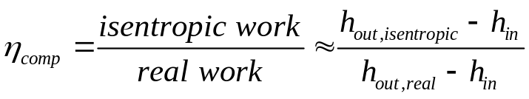

Compression modeling (2)
Isentropic efficiency
Modeling assumptions:
  Small external surface → Q=0
  Small internal volume → E_{system}, m_{system} neglected
  Kinetic energy neglected
Model:
  Isentropic efficiency (also called adiabatic efficiency) supposed to be known:
  Adiabatic process:
Isentropic efficiency:
  For a (liquid) pump : close to 1 (quasi-isentropic)
  For a (vapor) compressor: η depend essentially on working conditions → η(T,p) needs to be known (via experimental tests)

Slide 9
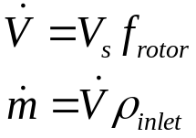
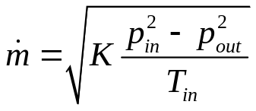
Compression modeling (3)
How to calculate the flow rate ?
Volume metric type :
  Ex: reciprocating and rotary compressors
  Rotational speed : number of turns of the rotor per second
  Flowrate depends on swept volume V_{s}, rotational speed and the inlet condition:
Dynamic type :
  Ex: Centrifugal compressor
  A specific correlation between the flowrate and working conditions is required
Expansion (turbine) modeling can be done using the similar method:
  Example of correlation for a centrifuge turbine
(K: characteristic constant of the component)

Slide 10
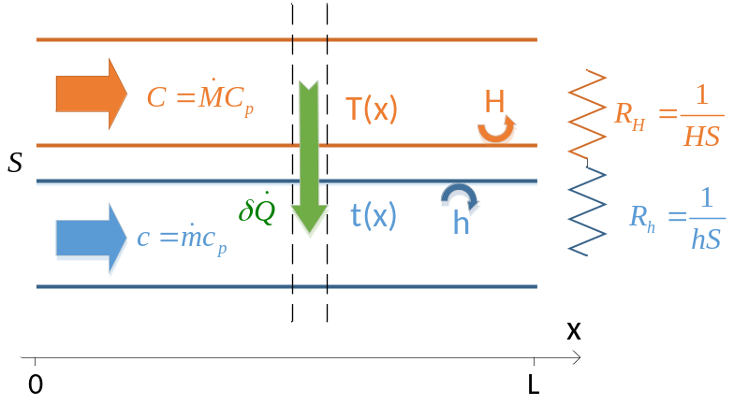
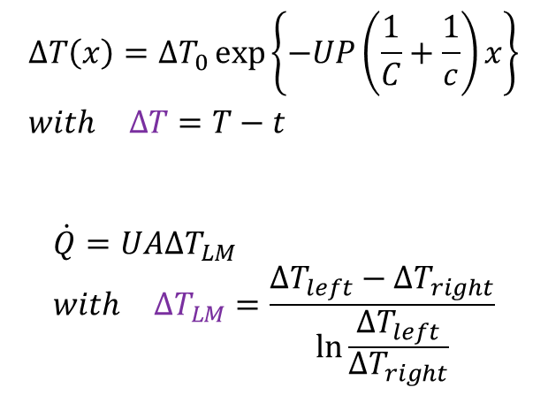
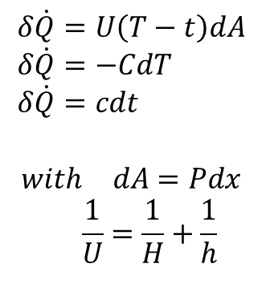
Analysis of heat exchanger
Simplified case
Heat exchanger allow to exchange heat between 2 fluids of different temperatures without mixing them
Assumptions:
Thermodynamics properties being constant
Wall thickness neglected
Exchange surfaces with the wall being the same
C, c : heat capacity rates (J/K)
$$ΔT\left(x\right)=ΔT_{0}\exp\left\{−UP\left(\frac{1}{C}+\frac{1}{c}\right)x\right\} \\ with ΔT=T−t$$
$$\dot{Q}=UAΔT_{LM} \\ with ΔT_{LM}=\frac{ΔT_{left}−ΔT_{right}}{\ln{\frac{ΔT_{left}}{ΔT_{right}}}}$$
$$δ\dot{Q}=U\left(T−t\right)dA \\ δ\dot{Q}=−CdT \\ δ\dot{Q}=cdt$$
$$with dA=Pdx \\ \frac{1}{U}=\frac{1}{H}+\frac{1}{h}$$
temperature difference
log mean
temperature difference

Slide 11
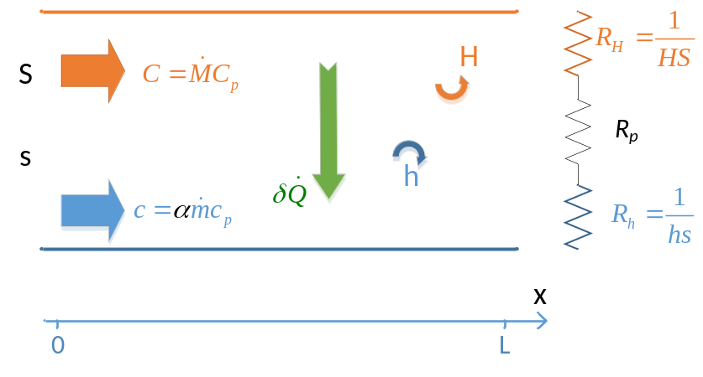
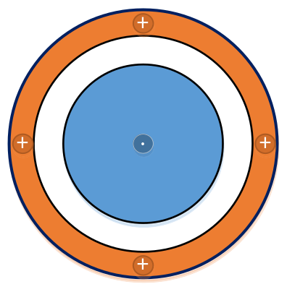
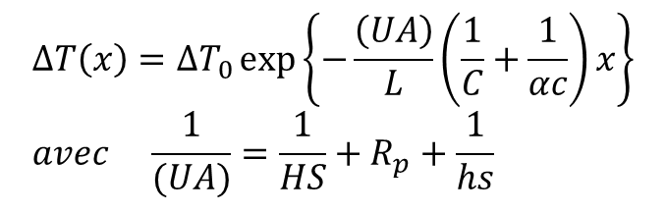
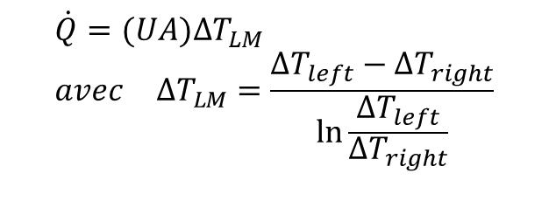
Analysis of heat exchanger (2)
Parallel-flow and counter-flow types
α = circulation indicator
$$ΔT\left(x\right)=ΔT_{0}\exp\left\{−\frac{\left(UA\right)}{L}\left(\frac{1}{C}+\frac{1}{αc}\right)x\right\} \\ avec \frac{1}{(UA)}=\frac{1}{HS}+R_{p}+\frac{1}{hs}$$
$$\dot{Q}=(UA)ΔT_{LM} \\ avec ΔT_{LM}=\frac{ΔT_{left}−ΔT_{right}}{\ln{\frac{ΔT_{left}}{ΔT_{right}}}}$$
These results are still correct in the following conditions:
  The exchange surfaces are different
  The wall conduction is considerable
  Counter-flow (α=-1) or parallel-flow (α=1)

Slide 12
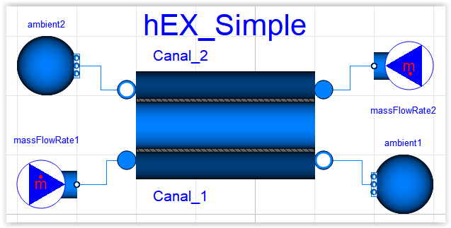
Heat exchanger modeling
Objective of design
Modeling a heat exchanger depends on the objectives:
  Objective of simulation (the system is already existed)
  Objective of design (the system is to be sized)
2b
2a
1a
1b

Slide 13
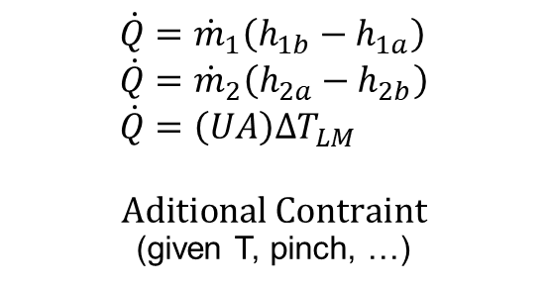
Heat exchanger modeling for design
$$\dot{Q}={\dot{m}}_{1}\left(h_{1b}−h_{1a}\right) \\ \dot{Q}={\dot{m}}_{2}\left(h_{2a}−h_{2b}\right) \\ \dot{Q}=\left(UA\right)ΔT_{LM}$$
$$\text{A}\text{ditional} \text{Contraint}$$
(given T, pinch, …)
2b
2a
UA calculated
1a
1b
A, a calculated
For given U, u
and surface ratio A/a

Slide 14
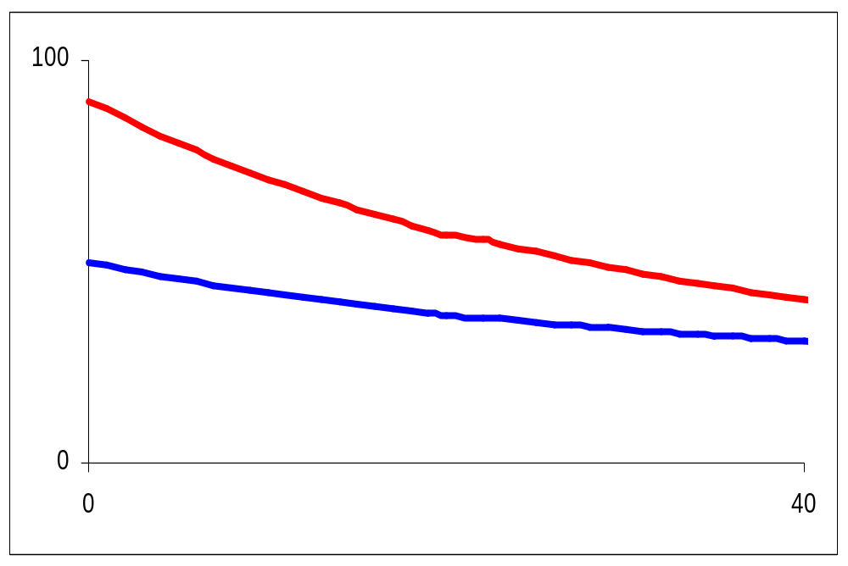
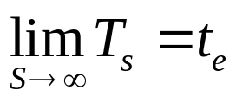
Pinch of a heat exchanger
T₀
ΔT₀
T_{L}
t₀
t_{L}
L
Pinch is defined as the minimum difference of the 2 fluid temperatures along the HEX
  In the case of no phase change, the pinch location is at one of two sides of the HEX
Pinch value results from the HEX surface (i.e. the HEX cost)
  In practice, a HEX is sized by fixing a pinch value

Slide 15

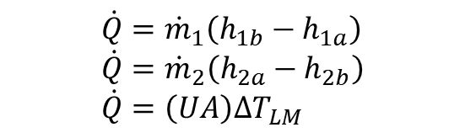

Heat exchanger modeling for simulation
$$\dot{Q}={\dot{m}}_{1}\left(h_{1b}−h_{1a}\right) \\ \dot{Q}={\dot{m}}_{2}\left(h_{2a}−h_{2b}\right) \\ \dot{Q}=\left(UA\right)ΔT_{LM}$$
T_out calculated,
but require solving log function
The method NUT calculateT_out with sequential calculs
$$NUT= \frac{UA}{C_{min}}$$
$$effectivness=f(NUT)$$
T_out

Slide 16
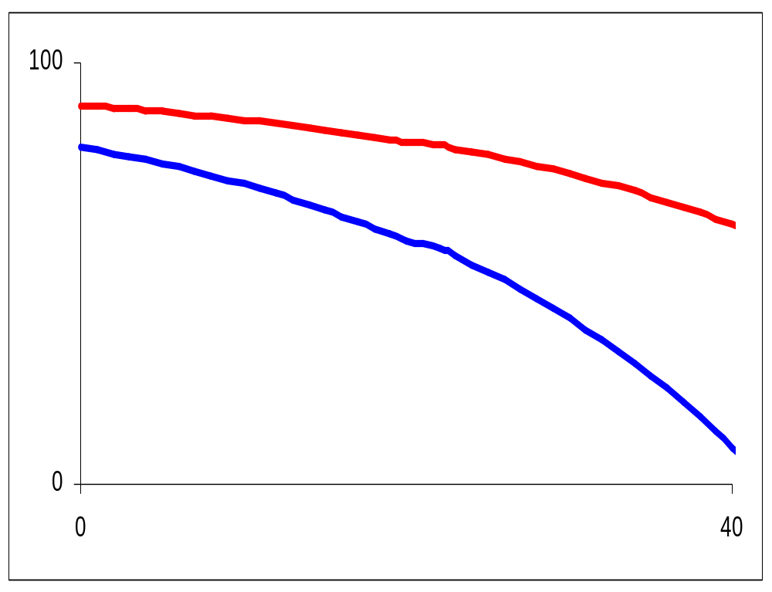
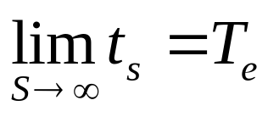
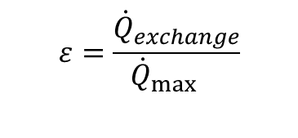
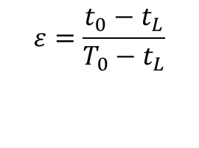
Effectiveness of heat exchanger
T₀
$$ε=\frac{{\dot{Q}}_{exchange}}{{\dot{Q}}_{\max{}}}$$
T_{L}
t₀
$$ε=\frac{t_{0}−t_{L}}{T_{0}−t_{L}}$$
t_{L}
L
Effectiveness = the ratio of actual heat transferred to the maximum possible heat transfer
Effectiveness result from the HEX surface (i.e. the HEX cost)
Effectiveness of counter flow > Effectiveness of parallel flow

Slide 17
Thank you !

